Slide 1
Logic Gates
LO: To understand what logic gates represent and the output of each gate
Overview
A logic gate is an electric circuit with two inputs and an output.
It receives two incoming electric currents, compares them, and sends on a new, outgoing electric current
There are quite a few different types of logic gate, the most common of which are called AND, OR, NOT, XOR (Exclusive Or), NAND (NOT AND), and NOR (NOT OR)

Slide 2
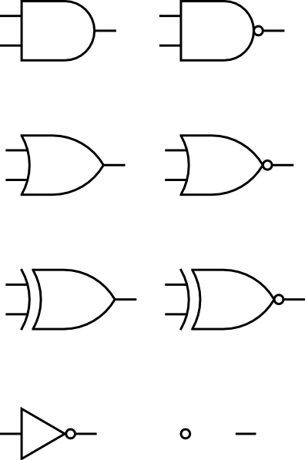
Logic Gates
LO: To understand what logic gates represent and the output of each gate
Logic Gate symbols
Logic circuits are drawn using symbols to represent each type of logic gate
Each logic gate can be represented in an electrical circuit. Here are some examples:

Slide 3
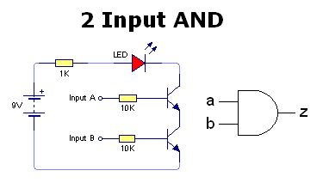
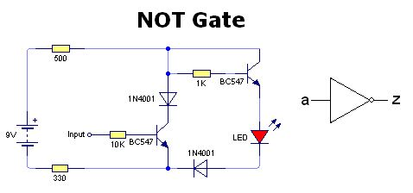
Logic Gates
LO: To understand what logic gates represent and the output of each gate
Logic Gates in electrical circuits

Slide 4
Logic Gates
LO: To understand what logic gates represent and the output of each gate
Logic Gate outputs
Each logic gate accepts two inputs (except the NOT gate) and provides one output
The rules for each logic gate are as follows:
AND Gates OR Gates
Truth table
X | Y | Q
0 | 0 | 0
0 | 1 | 0
1 | 0 | 0
1 | 1 | 1
X | Y | Q
0 | 0 | 0
0 | 1 | 1
1 | 0 | 1
1 | 1 | 1

Slide 5
Logic Gates
LO: To understand what logic gates represent and the output of each gate
Logic Gate outputs
Each logic gate accepts two inputs (except the NOT gate) and provides one output
The rules for each logic gate are as follows:
NOT Gates XOR Gates
X | Q
0 | 1
1 | 0
X | Y | Q
0 | 0 | 0
0 | 1 | 1
1 | 0 | 1
1 | 1 | 0

Slide 6
Logic Gates
LO: To understand what logic gates represent and the output of each gate
Logic Gate outputs
Each logic gate accepts two inputs (except the NOT gate) and provides one output
The rules for each logic gate are as follows:
NAND Gates NOR Gates
X | Y | Q
0 | 0 | 1
0 | 1 | 1
1 | 0 | 1
1 | 1 | 0
X | Y | Q
0 | 0 | 1
0 | 1 | 0
1 | 0 | 0
1 | 1 | 0

Slide 7
Logic Gates
LO: To understand what logic gates represent and the output of each gate
Logic Gate outputs
Each logic gate accepts two inputs (except the NOT gate) and provides one output
The rules for each logic gate are as follows:
XNOR Gates
X | Y | Q
0 | 0
0 | 1
1 | 0
1 | 1

Slide 8
Task:
Draw each logic gate and it’s truth table

Slide 9
Logic Gates
LO: To understand what logic gates represent and the output of each gate
Logic Gate circuits
Logic gates can be combined to create logic circuits. See if you can figure out the output for the following logic gate circuits:
X
X | Y | X.Y | Q
0 | 0
0 | 1
1 | 0
1 | 1
Q
Y

Slide 10
Logic Gates
LO: To understand what logic gates represent and the output of each gate
Logic Gate circuits
Logic gates can be combined to create logic circuits. See if you can figure out the output for the following logic gate circuits:
X
X | Y | X+Y | Q
0 | 0
0 | 1
1 | 0
1 | 1
Q
Y

Slide 11
Logic Gates
LO: To understand what logic gates represent and the output of each gate
Logic Gate circuits
Logic gates can be combined to create logic circuits. See if you can figure out the output for the following logic gate circuits:
X
X | Y | X+Y | Q
0 | 0
0 | 1
1 | 0
1 | 1
Q
Y

Slide 12
Logic Gates
LO: To understand what logic gates represent and the output of each gate
Logic Gate circuits
Logic gates can be combined to create logic circuits. See if you can figure out the output for the following logic gate circuits:
X
X | Y | X.Y | Q
0 | 0
0 | 1
1 | 0
1 | 1
Q
Y

Slide 13
Logic Gates
LO: To understand what logic gates represent and the output of each gate
Logic Gate circuits
Logic gates can be combined to create logic circuits. See if you can figure out the output for the following logic gate circuits:
A
A | B | Q
0 | 0
0 | 1
1 | 0
1 | 1
B
Q
C
D

Slide 14
Logic Gates
LO: To understand what logic gates represent and the output of each gate
Logic Gate circuits
Logic gates can be combined to create logic circuits. See if you can figure out the output for the following logic gate circuits:
A
A | B | Q
0 | 0
0 | 1
1 | 0
1 | 1
B
Q
C
D

Slide 15
Logic Gates
LO: To understand what logic gates represent and the output of each gate
Logic Gate circuits
Logic gates can be combined to create logic circuits. See if you can figure out the output for the following logic gate circuits:
A
A | B | Q
0 | 0
0 | 1
1 | 0
1 | 1
B
Q
C
D

Slide 16
Logic Gates
LO: To understand what logic gates represent and the output of each gate
Task:
Using the logic gates we have discussed this lesson, draw 3 logic circuits.
Swap these with a partner and identify what the output is
Then check the answer is correct by comparing answers

Slide 17
Logic Gates
LO: To understand what logic gates represent and the output of each gate
Boolean expressions for Logic gates / circuits
As well as using the symbols to represent Boolean logic, equations can be used.
Symbol
Equation
Symbol
Equation
Symbol
Equation
A.B
A.B
A+B
A+B
A+B
A
A+B

Slide 18
Logic Gates
LO: To understand what logic gates represent and the output of each gate
Task
How would you represent the following using Boolean expressions:
A AND B
A XOR B
NOT A AND B
A NOR B
A XOR B
A XNOR B
(NOT A) AND B
A OR (NOT B)

Slide 19
Logic Gates
LO: To understand what logic gates represent and the output of each gate
Task
Go back to the logic circuits you drew and try to write the Boolean expressions for each of them.
Use brackets to help you with the order of operation

Slide 20
Logic Gates
LO: To understand what logic gates represent and the output of each gate
Homework
Is it possible to replicate the logic of each of the following gates using just NAND gates?
AND
OR
NOT
NOR
Research this, and then draw and label diagrams to show how this is possible

Slide 21















Key words:
Noted clearly
Topic specific vocabulary wherever necessary
Icon for extension activity if appropriate
Icon same colour as dept ex book
You might want to develop subject specific icons

